Slide 1

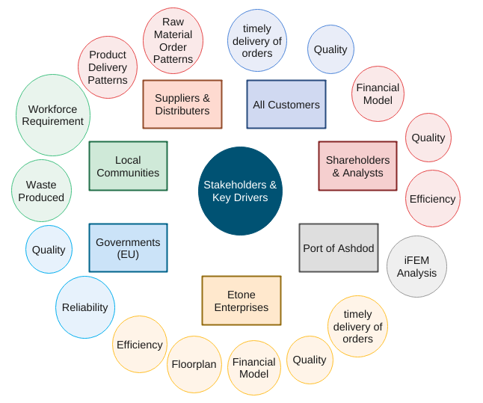
ME Module 11 : Production Systems Engineering
Group 2 | Faculty of Engineering Technology (ET)
University of Twente, Netherlands | 2022
Systems Engineering
Kirtan Patel (s2935848),
Sally Ayman Ahmed Mohamed (s2273144)
Stakeholders & Key Drivers
N² Architecture
Etone |  | 1 |  |  | 2
 | Factory |  |  |  | 12 |  | 11
 |  | PP&C | 3 | 3,4 | 3
7 |  |  | PFD | 6 | 7
8 |  |  | 5 | F&IM | 5 | 8 | 5
9 |  | 13 |  |  | QC&RM | 9
 |  |  |  |  | 12 | Stake- holders
 | 10 |  |  |  | 12 | 11 | Suppl. & Dist.
Subsystem Abbreviations :
PP&C : Production Planning & Control
PFD : Production Flow Design
F&IM : Finance & Inventory Management
QC&RM : Quality Control & Risk Mitigation
The orange interfaces are Materials. This includes :
Raw Material
Manufactured Product
The other interfaces are Information. This includes :
Inventory Plans, Order Plan,
Assets and Inventory
Requirements
Performance Reports, Financial Plans
Production System Layout
The green interfaces are information interfaces activated when a failure occurs. This includes :
Lack of workforce on certain days
Lack of inventory
Unexpected Machine Failure
Functional Flow
1. Order Forecast, Existing Machinery List
2. Performance Requirements
3. Production Sequence & Schedule
4. Machinery Requirement
5. Inventory & Delivery Order Plan
6. Land Resource Requirements
7. Factory Layout
8. Financial Projections
9. System & Product Performance
10. Raw Material
11. Manufactured Product
12. Failure
13. Risk & Maintenance Protocol
System Integration
Conclusion
References: [1] Systems Design and Engineering - G. Maarten Bonnema, Karel Th. Veenvliet, Jan F. Broenink
[2] A3 Architecture overviews: A tool for effective communication in product evolution - P. Daniel Borches
[3] http://www.a3ao.eu/
[4] https://esi.nl/research/output/methods/a3-system-overview
UNIVERSITY OF TWENTE.

